Slide 1
Chapter 6: Fundamental Laptops and Portable Devices
IT Essentials: PC Hardware and Software v4.1
Notes:
Cisco Networking Academy program
IT Essentials: PC Hardware and Software v4.1
Chapter 6: Fundamental Laptops and Portable Devices

Slide 2
Chapter 6 Objectives
6.1 Describe laptops and other portable devices
6.2 Identify and describe the components of a laptop
6.3 Compare and contrast desktop and laptop components
6.4 Explain how to configure laptops
6.5 Compare the different mobile phone standards
6.6 Identify common preventive maintenance techniques used for laptops and portable devices
6.7 Describe how to troubleshoot laptops and portable devices
Notes:
Chapter 6 Objectives

Slide 3
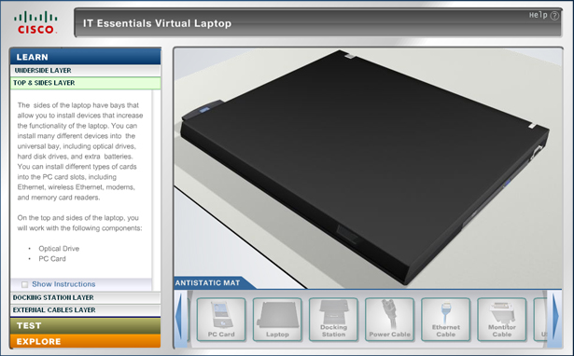
Virtual Laptop
Virtual laptop is a stand-alone tool designed to:
  supplement classroom learning
  provide a virtual “hands-on” experience where real equipment is limited
Notes:
The virtual laptop and Virtual Desktop are stand-alone tools designed to supplement classroom learning and provide an interactive “hands-on” experience in learning environments with limited physical equipment. Hands-on labs will remain an essential element of the course.
System requirements to use the virtual laptop include a minimum of 512MB RAM and Windows 2000 or XP.
All virtual laptop activities are optional.

Slide 4
Laptops and Portable Devices
Notebooks, laptops, and tablets are types of portable computers. For clarity and consistency in this course, all portable computers will be called "laptops".
Personal Digital Assistants (PDAs) offer features such as games, web surfing, e-mail, instant messaging, and many other features offered by PCs.
Smartphones are cell phones with many built-in PDA capabilities.
Notes:
6.1.1 Identify some common uses of laptops
Common uses of laptops include:
Taking notes in school or researching papers
Presenting information in business meetings
Accessing data away from home or the office
Playing games while traveling
Watching movies while traveling
Accessing the Internet in a public place
Sending and receiving email in a public place
Can you think of other uses for laptops?
Other uses for a laptop are traditional desktop functions plus portability (Office productivity, doctor offices, filling out forms, utility meter readers)
6.1.2 Identify some common uses of PDAs and smartphones
The PDA is an electronic personal organizer with tools to help organize information: Address book, Calculator, Alarm clock, Internet access, Email, Global positioning. The Smartphone is a mobile phone with PDA capabilities.
Other uses of PDAs and Smartphones are to take phone calls, voice memos, taking notes, taking pictures, text messaging, browsing the internet, reading eBooks, playing games, internet chat, music, contacts, calendar and GPS.
Student Activity: The student course content includes the worksheet, 6.1.2 Research Laptops, Smartphones, and PDAs. To complete this worksheet, students will conduct research on laptops and other portable devices they would like to own. In this activity, students will list the details of the features and specifications along with the purchase price. Students might use various resources to gather this information. Resources may include the Internet, a newspaper, and/or a visit to a local store or advertisements.

Slide 5
Components of a laptop
Common laptop features:
  Integrated display screen in lid
  Integrated keyboard
  AC power source or rechargeable battery
  Hot-swappable drives and peripherals
  Docking station or port replicator to connect to peripherals
Notes:
6.2 Identify and describe the components of a laptop
In this section, students will look closely at the components of a laptop and will also examine a docking station. Remember, laptops and docking stations come in many models. Components may be located in different places on different models.

Slide 6
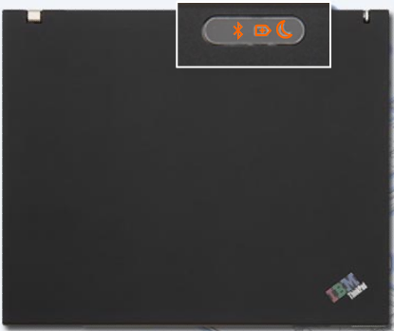
Components on the outside of a laptop
Top view of virtual laptop
Bluetooth status LED
Standby LED
Battery status LED
Notes:
6.2.1 Describe the components found on the outside of a laptop
Potential misconception: Not all laptops are the same. The virtual laptop will have components that are not found on all laptops. Also, the location of each component may vary.
Top view of the virtual laptop
The Bluetooth status LED indicates when the Bluetooth wireless transceiver is enabled. Bluetooth is a wireless industry standard that enables portable devices to communicate over short distances.
The battery status LED indicates the condition of the computer battery. A laptop computer can use a battery or an AC power adapter to operate. The type of battery and how the laptop is used affects how long a battery charge will last.
The Standby LED indicates the power status of the laptop. Standby mode reduces the amount of electricity used by the laptop by shutting off the monitor, hard drive, and CPU. A small amount of electricity is used to keep the RAM active and to make the data available. A laptop computer may enter standby mode when it has not been used for a predefined amount of time.
[If there is a laptop available, demonstrate the locations of the callouts to the students.]

Slide 7

Components on the outside of a laptop (Continued)
Rear view of virtual laptop
Parallel port
AC power connector
Battery bay
Notes:
6.2.1 Describe the components found on the outside of a laptop
Rear view of the virtual laptop
The battery bay is a connector that is used to attach a laptop battery.
The AC power connector is a connector that is used to attach the AC power adapter to the laptop and to charge the battery.
The parallel port is a socket that is used to connect a device such as a printer or scanner.
[If there is a laptop available, demonstrate the locations of the callouts to the students.]

Slide 8

Components on the outside of a laptop (Continued)
Left side view of virtual laptop
Ventilation grill
RJ-11 modem
Network LEDs
USB port
Ethernet port
Microphone jack
PC card slot
Security keyhole
S-video port
Headphone jack
Notes:
6.2.1 Describe the components found on the outside of a laptop
Left side view of the virtual laptop
The security keyhole is a hard point in the laptop frame that is used to attach a security cable.
The Universal Serial Bus (USB) port is a socket that is used to connect one or more peripherals.
The S-video port is a four-pin mini-DIN connector that is used to send video signals to a compatible device. S-video separates the brightness and color portions of a video signal.
The RJ-11 modem port is a device that is used to connect the laptop to a standard telephone line. The modem can be used to connect the computer to the Internet, to fax documents, and to answer incoming calls.
The Ethernet port is an RJ-45 socket that is used to connect the laptop to a cabled local area network.
The two network LEDs are lights that indicated the status of the network connection. The green link light indicates network connectivity. The outer LED light indicates the traffic to and from the laptop.
The headphone jack is a socket that is used to output audio signals to connected stereo headphones or speakers.
The microphone jack is a socket that is used to connect a microphone used for audio input.
The ventilation grill is a series of vents that allow hot air to be expelled from the interior of the laptop.
The PC combination card slot is an expansion slot that supports the PCExpress expansion cards in the top slot and PC cards in the bottom slot.
[If there is a laptop available, demonstrate the locations of the callouts to the students.]

Slide 9

Components on the outside of a laptop (Continued)
Front view of virtual laptop
Latch
Infrared port
Speakers
Ventilation grill
Notes:
6.2.1 Describe the components found on the outside of a laptop
Front view of the virtual laptop
The infrared port is a line-of-sight wireless transceiver that is used for data transmission.
Speakers are an output device that converts audio signals that are produced within the laptop to sound.
The laptop latch is a lever that is used to open the laptop lid.
The ventilation grill is a series of vents that allow hot air to be expelled from the interior of the laptop.
[If there is a laptop available, demonstrate the locations of the callouts to the students.]

Slide 10

Components on the outside of a laptop (Continued)
Right side view of virtual laptop
Optical drive
VGA port
Optical drive indicator
Drive bay indicator
Notes:
6.2.1 Describe the components found on the outside of a laptop
Right side view of the virtual laptop
The optical drive is a disk drive that is used to read and write to CDs and DVDs.
The optical drive activity indicator is an LED that illuminates when the drive is in use.
The drive bay status indicator is an LED that illuminates when a drive is installed in the laptop bay.
The VGA port is a 15-pin socket that connects to external displays and projectors.
[If there is a laptop available, demonstrate the locations of the callouts to the students.]

Slide 11
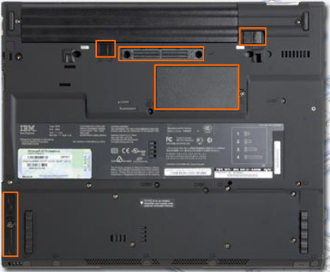
Components on the outside of a laptop (Continued)
Underside view of virtual laptop
Battery latches
Docking connector
RAM access panel
Hard drive access panel
Notes:
6.2.1 Describe the components found on the outside of a laptop
Underside view of the virtual laptop
The hard drive access panel is a cover that provides access to the internal hard drive bay.
The two battery latches are levers that are used when inserting, removing or securing the laptop battery.
The docking connector is a socket that is used to attach a laptop to a docking station.
The RAM access panel is a cover that provides access to the expansion memory.
[If there is a laptop available, demonstrate the locations of the callouts to the students.]
Optional Student Activity: The student course content includes an optional virtual laptop activity for students to explore the different views of the virtual laptop. This student activity should be performed in the Explore Mode of the virtual laptop. System requirements to use the virtual laptop include a minimum of 512MB RAM and Windows 2000 , XP or Vista.

Slide 12
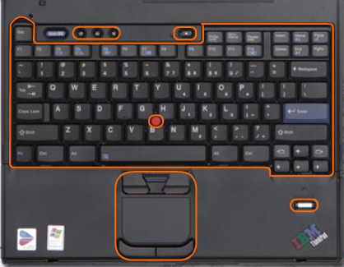
Components on the inside of a laptop
Open view of laptop
Volume controls
Power button
Pointer controller
Keyboard
Fingerprint reader
Touchpad
Notes:
6.2.2 Describe the components found on the inside of the laptop
The virtual laptop is also used to illustrate the components found on the inside of a laptop.
Open inside view of the virtual laptop
The keyboard is a compact input device and has multi-functional keys.
The volume controls are buttons that control audio output.
The input devices are the touch pad, which consists of right and left click buttons, and a pointer controller. The touchpad and pointer controller can be used instead of a mouse for the laptop.
The power button is a control that turns the laptop on and off.
The fingerprint reader is an input device used for security authentication.
Not all laptop input devices are built-in.
Laptops use input devices to add functionality to the laptop. Installing input devices might require downloading drivers from the manufacturer's website.
Some input devices might need to be configured or optimized for speed, sensitivity, scrolling, or the number of taps needed. To gain access to these configuration utilities for input devices, use the following path: Start > Control Panel > Mouse
Not all devices can be configured through the Control Panel. When you install the software for some devices, programs might be installed in the All Programs section of the Start menu. These programs are used to configure more advanced settings.
[If there is a laptop available, demonstrate the locations of the callouts to the students.]

Slide 13

Components on the inside of a laptop (Continued)
LEDs inside laptop
Hard drive
Num lock
Battery
Wireless
Bluetooth
Caps lock
Power on
Standby
Notes:
6.2.2 Describe the components found on the inside of the laptop
LEDs inside of the virtual laptop
The wireless LED indicates the activity of the wireless network connection.
The Bluetooth status LED indicates when the Bluetooth wireless transceiver is enabled. Bluetooth is a wireless industry standard that enables portable devices to communicate over short distances.
The num lock LED indicates the on/off status of the 10-key number pad.
The caps lock LED indicates the on/off status of the caps lock.
The hard drive activity LED indicates the activity of the hard drive.
The power on LED indicates the on/off status of the laptop.
The battery status LED indicates the condition of the laptop battery. A laptop can use a battery or an AC power adapter to operate.
The hibernate or standby LED indicates whether the computer is in standby mode or if it is entering or leaving hibernate mode.
[If there is a laptop available, demonstrate the locations of the callouts to the students.]
Optional Student Activity: The student course content includes an optional virtual laptop activity for students to explore the virtual laptop keyboard. This student activity should be performed in the Explore Mode of the virtual laptop. System requirements to use the virtual laptop include a minimum of 512MB RAM and Windows 2000, XP or Vista.

Slide 14
Components on the inside of a laptop (Continued)
Monitor, Fn key, and Function keys F1 through F12
A laptop monitor is a built-in LCD.
The Fn key is used to activate a second function on
a dual-purpose key.
The purpose of the Function keys F1-to-F12
depends on the operating system and the application running.
Individual function keys can perform up to seven separate operations when pressed alone or in combination with the Shift, Control, and Alt keys.
Notes:
6.2.2 Describe the components found on the inside of the laptop
A laptop monitor is similar to a desktop LCD monitor, except that the resolution, brightness, and contrast settings can be adjusted using software or button controls. The laptop monitor cannot be adjusted for height and distance because it is integrated into the lid of the case. A desktop monitor can be added to a laptop. An Fn key on the laptop keyboard toggles between the laptop display and the desktop monitor.
The purpose of the Fn key is to activate a second function on a dual-purpose key:
Volume setting
Display brightness
Sleep states
Wireless functionality
Check battery status
The feature that is accessed by pressing and holding the Fn key is printed on another key in a smaller font or different color.
The Fn key must not be confused with function keys F1 through F12. These keys are typically located in a horizontal row across the top of the keyboard.

Slide 15
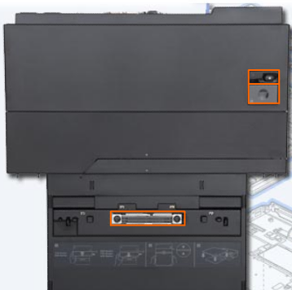
Components on a docking station
Top view of docking station
Power button
Eject button
Docking connector
Notes:
6.2.3 Describe the components found on the laptop docking station
Top view of the virtual laptop docking station
The docking connector is a socket that is used to attach a laptop to a docking station. Docking stations and port replicators use a variety of connection types:
Manufacturer- and model-specific
USB or FireWire
PC-Card or ExpressCard
The eject button is a lever that releases the laptop from the docking station so that the laptop can be removed.
The power button is a control that turns the power on and turns the power off to the laptop when the laptop is connected to the docking station.
[If there is a docking station or port replicator available, demonstrate the locations of the callouts to the students.]

Slide 16
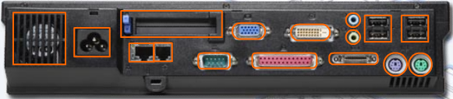
Components on a docking station (Continued)
Rear view of docking station
Headphone connector
USB port
AC power connector
PC card slot
VGA port
DVI port
Line In connector
Exhaust vent
Ethernet port
RJ-11 port
Serial port
Parallel port
Keyboard port
External-diskette-drive connector
Mouse port
Notes:
6.2.3 Describe the components found on the laptop docking station
Rear view of docking station
The exhaust vent is an outlet that expels hot air from the interior of the docking station.
The AC power connector is a socket that is used to connect the AC power adapter to the docking station.
The Ethernet port is an RJ-45 socket that is used to connect the laptop to a cabled local area network.
The RJ-11 modem port is a device that is used to connect the laptop to a standard telephone line. The modem can be used to connect the computer to the Internet, to fax documents, and to answer incoming calls.
The PC combination card slot is an expansion slot that supports the PC Express expansion cards in the top slot and PC cards in the bottom slot.
The serial port is a socket that is used to connect a device such as a mouse or trackball.
The VGA port is a 15-pin socket that allows output to external displays and projectors.
The parallel port is a socket that is used to connect a device such as a printer or scanner.
The DVI port is a socket that is used to attach a digital video monitor.
The external-diskette-drive connector is a socket that is used to connect an external disk drive.
The headphone connector is a socket that is used to attach an audio output device.
The Line In connector is a socket that is used to attach an audio source.
The Universal Serial Bus (USB) port is a socket that is used to connect one or more peripherals.
The keyboard port is a PS/2 socket that is used to attach an external keyboard.
The mouse port is a PS/2 socket that is used to attach an external mouse.
[If there is a laptop available, demonstrate the locations of the callouts to the students.]

Slide 17
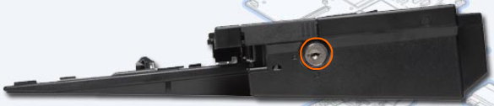
Components on a docking station (Continued)
Right side view of docking station
Key lock
Notes:
6.2.3 Describe the components found on the laptop docking station
Right side view of docking station
The key lock is a socket into which a key is inserted to lock the laptop to the docking station.
[If there is a laptop available, demonstrate the locations of the callouts to the students.]
Optional Student Activity: The student course content includes an optional virtual laptop activity for students to explore the different views of the virtual laptop docking station. This student activity should be performed in the Explore Mode of the virtual laptop. System requirements to use the virtual laptop include a minimum of 512MB RAM and Windows 2000 or XP.
Student Activity: The student course content includes the worksheet, 6.2.3 Complete Docking Stations True or False Questions. To complete this worksheet, students will review statements about the virtual laptop docking station and mark each statement as either “True” or “False”.

Slide 18
Compare desktop components and laptop components
Desktop components tend to be standardized. They usually meet universal form factors.
Laptop manufacturers focus on refining laptop components to make them more efficient and compact as a result, laptop components are proprietary.
You may not be able to use components made by one laptop manufacturer to repair a laptop made by another manufacturer.
Notes:
6.3 Compare and contrast desktop and laptop components
NOTE: Technicians may have to obtain certification for each laptop manufacturer that they support.

Slide 19
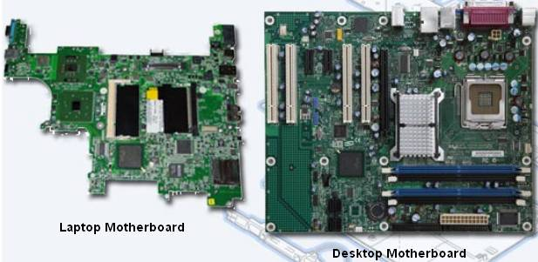
Compare desktop and laptop motherboards
Notes:
6.3.1 Compare and contrast desktop and laptop motherboards
Desktop motherboards have standard form factors, which allow desktop motherboards from different manufacturersto be interchangeable.
Form factors include: AT, LPX, NLX, ATX, and BTX.
Expansion slot types include: PCI, PCIe, ISA, and AGP.
RAM slot types include: SIMM, DIMM, and RIMM.
Laptop motherboards vary by manufacturer and are proprietary. It is strongly recommended that you obtain a replacement motherboard from the manufacturer of the laptop.
Expansion slot types include: Mini-PCI.
RAM slot types include: Small Outline Dual In-line Memory Modules (SODIMMs) to accommodate space restrictions.
[If there are laptop and desktop motherboards available, show them to the students, possibly allow them to be passed around.]

Slide 20
Compare desktop and laptop CPUs
Laptop processors are designed to use less power and create less heat than desktop processors. As a result, laptop processors do not require cooling devices that are as large as those found in desktops.
Laptop processors also use CPU throttling to modify the clock speed as needed to reduce power consumption and heat. These specially-designed processors allow a laptop to operate longer when using a battery.
Notes:
6.3.2 Compare and contrast desktop and laptop processors
NOTE: Technicians should refer to the laptop manual for processors that can be used as replacement processors and for processor replacement instructions.
Common Error: Lower voltage does not necessarily equal lower speed.

Slide 21
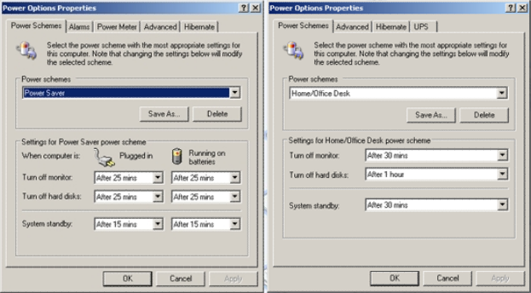
Compare desktop and laptop power options
Laptop Power Options
Desktop Power Options
Notes:
6.3.3 Compare and contrast desktop and laptop power management
Power management controls the flow of electricity to the components of a computer.
Unlike a desktop computer power supply, laptops can accept only DC power. AC adapters convert unregulated AC power to the regulated DC power required to run the laptop and charge the laptop battery.
There are two methods of power management:
Advanced Power Management (APM) is an earlier version of power management. With APM, the BIOS was used to control the settings for power management.
Advanced Configuration and Power Interface (ACPI) has replaced APM. ACPI offers additional power management features. With ACPI, the operating system controls power management.

Slide 22
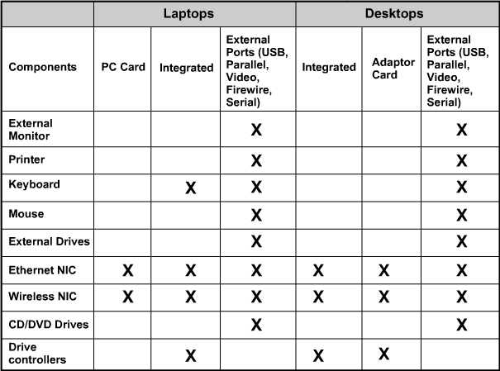
Compare desktop and laptop expansion capabilities
Notes:
6.3.4 Compare and contrast desktop and laptop expansion capabilities
Expansion devices are attached to laptops and desktops differently. A desktop attaches these devices with serial, parallel, USB, and FireWire ports. A laptop attaches these devices with the same ports and PC Cards.
Desktops have internal bays that support 3.5" drives. Additionally, there is space to install other permanent expansion drives.
Laptops have limited space so the expansion bays on laptops are designed to allow different types of drives to fit into the same bay. Drives are hot-swappable and are inserted or removed as needed.
Laptops use the PC Card slot to add functionality. The PC Card slot uses an open standard interface to connect to peripheral devices using the CardBus standard.
PC Cards follow the PCMCIA standard. They come in three types: Type I (SRAM Flash), Type II (Modem, LAN, Wireless), and Type III (Hard Drive). Each type of PC Card is different in size and can attach to different devices.
A newer type of PC Card is called the PC ExpressCard. Express Card follows the Express Bus standard. They come in two types: Express Card/34 (Firewire, TV Tuner, Wireless NIC), and Express Card/54 (Smart Card reader, Compact Flash reader, 1.8-inch disk drive).
Student Activity: The student course content includes the worksheet, 6.3.4 Answer Laptop Expansion Questions. To complete this worksheet, students will answer questions regarding the details of laptop expansion.

Slide 23
Configure Laptops
To allow applications and processes to run smoothly:
  Configure and allocate system resources.
  Install additional components and plug-ins.
  Change environmental settings to match software requirements.
A laptop can be customized for specific purposes by adding external components. Adding external components is usually accomplished through the use of Plug and Play, but occasionally driver installation and additional configuration may be required.
Follow safe removal procedures when disconnecting hot-swappable and non-hot-swappable devices.
Notes:
6.4 Explain how to configure laptops

Slide 24
Configure Laptop Power Settings
The Advanced Configuration and Power Interface (ACPI) standards create a bridge between the hardware and OS and allow technicians to create power management schemes to get the best performance from the computer.
The ACPI standards are applicable to most computers, but they are particularly important when managing power in laptops.
These are the steps to access the ACPI settings in the BIOS:
  Enter BIOS setup by pressing the appropriate key or key combination while the computer is booting. Typically this is the Delete key or the F2 key, but there are several other options.
  Locate and enter the “Power Management settings” menu item.
  Use the appropriate keys to enable ACPI mode.
  Save and Exit BIOS setup.
Notes:
6.4.1 Describe how to configure power settings
Proper configuration of the power settings will help you get the maximum performance from a laptop, such as increasing the length of time the laptop can be used on battery power.
ACPI Standards
S0: The computer is on and the CPU is running.
S1: The CPU is not running. However, the CPU and RAM are still receiving power.
S2: The CPU is off, but the RAM is refreshed. The system is in a lower power mode than S1.
S3: The CPU is off, and the RAM is set to a slow refresh rate. This mode is often called “Save to RAM”. In Windows XP, this state is known as the Standby mode.
S4: The CPU and RAM are off. The contents of RAM have been saved to a temporary file on the hard disk. This mode is also called “Saved to Disk”. In Windows XP, this state is known as the Hibernate mode.
S5: The computer is off and nothing has been saved.
NOTE: When working in Windows XP or Windows Vista, the ACPI power management mode must be enabled in BIOS to allow the OS to configure all of the power management states.
Technicians frequently are required to configure power settings by changing the settings found in BIOS. Configuring power settings in BIOS affects the following conditions:
System states
Battery and AC modes
Thermal management
CPU PCI bus power management
Wake-On-LAN (WOL)
NOTE: WOL might require a cable connection inside the computer from the network adapter to the motherboard.
NOTE: There is no standard name for each power management state. Manufacturers might use different names for the same state.
NOTE: These steps are common to most laptops and should be used only as a guideline. Be sure to check your laptop manual for specific configuration settings.

Slide 25
Power Settings in Windows XP and Vista
The Power Options feature in Windows XP or Windows Vista allows you to reduce the power consumption of a number of devices or of the entire system. Use Power Options to control the power management features of the following:
  Hard drive
  Display
  Shut Down, Hibernate, and Suspend modes (Windows XP)
  Shut Down, Hibernate, and Sleep modes (Windows Vista)
  Low-battery warnings
  To configure your power settings, click:
  Start > Control Panel > Power Options
Notes:
6.4.1 Describe how to configure power settings
You can adjust power management by using Power Options in the Control Panel. The Power Options displays only the options that can be controlled.
NOTE: Power Options automatically detects devices that might be unique to your computer; therefore, the Power Options windows might vary by the hardware that is detected.
To configure your power settings, click: Start > Control Panel > Power Options
Managing Power Usage
When you open Power Options, you will notice that Windows XP has preset power schemes and Windows Vista has preset power plans. These are the default settings and were created when the operating system was installed. You can use the default setting, or create customized schemes or plans that are based on specific work requirements.
To configure sleep timers in Windows XP, click: Start > Control Panel > Power Options > select the time you want.
To configure sleep timers in Windows Vista, click: Start > Control Panel > Power Options > click the link Change when the computer sleeps > select the time you want.
Setting the Laptop Power Options
If you do not want to completely shut down the laptop, you have two options in Windows XP – Standby and Hibernate.
Standby – Documents and applications are saved in RAM, allowing the computer to power on quickly
Hibernate – Documents and applications are saved to a temporary file on the hard drive, and will take a little longer than Standby to power on.
If you do not want to completely shut down the laptop, you have three options in Windows Vista: Sleep, Hybrid Sleep and Hibernate.
Sleep – Documents and applications are saved in RAM, allowing the computer to power on quickly.
Hybrid Sleep – Documents and applications are saved in RAM and data is written to the hard disk, and takes a little longer than Sleep to power on.
Hibernate – Documents and applications are saved to a temporary file on the hard drive, and takes a little longer than Hybrid Sleep to power on.
Adjusting Low Battery Warnings
In Windows XP, you can set the low battery warnings. There are two levels: Low Battery Alarm and Critical Battery Alarm. The Low Battery Alarm will warn you that the battery is low. The Critical Battery Alarm will initiate a forced standby, hibernate, or shutdown. Standby is called Sleep in Windows Vista.
Student Activity: The student course content includes the worksheet, 6.4.1 Match ACPI Standards. To complete this worksheet, students will write in the appropriate ACPI standard to match the power management state description.

Slide 26
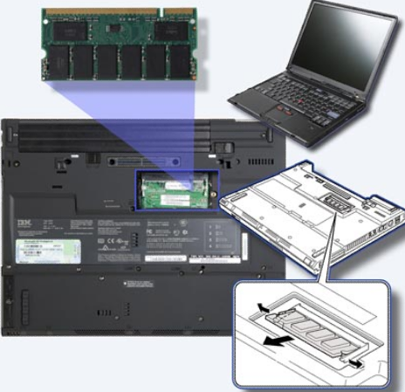
Replacing Laptop Components
CAUTION: Always disconnect power and remove the battery before installing or removing laptop components that are not hot-swappable.
Notes:
6.4.2 Describe the safe installation and removal of laptop components
[If there is a laptop available, demonstrate the removal and re-installation of the laptop battery, hard drive, RAM, and PC card.]
NOTE: Each laptop manufacturer uses unique hardware installation and removal procedures. Check the laptop manual for specific installation information and follow safety installation and ESD precautions.
CAUTION: Always disconnect power and remove the battery before installing or removing laptop components that are not hot-swappable. AC adapters must be compatible with the manufacturer and model of laptop that you have. AC adapters are either auto-switching or fixed input. Auto-switching AC adapters can switch between 110V and 220V, while a fixed input AC adapter only operates under a specific voltage. Auto switching allows the power supply to be used in different countries.
The student course content details the steps for replacing a battery, an optical drive, a hard drive, expansion memory, a PC expansion card, and a hot-swappable device.
CAUTION: On some laptops, the PC Card, Optical Drive, and USB devices are hot-swappable. However, the internal hard drive, RAM and battery are NOT hot-swappable.
Optional Student Activity: The student course content includes an optional virtual laptop activity for students to replace components and devices in the virtual laptop. This student activity should be performed in the Explore Mode of the virtual laptop. System requirements to use the virtual laptop include a minimum of 512MB RAM and Windows 2000, XP and Vista.

Slide 27
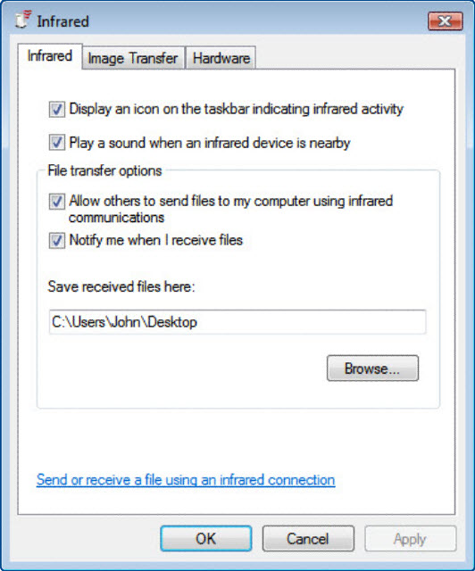
Laptop Communication Methods
Laptops use several different communication methods:
  Ethernet
  Wireless Ethernet
  Modem
  Bluetooth
  Infrared
  Cellular WAN
Notes:
6.4.3 Laptop communication hardware installation and configuration
The student course content details the steps for installing and configuring Ethernet, Wireless Ethernet, Modem, Bluetooth, Infrared, and Cellular WAN devices.
Ethernet Installation and Configuration Steps
Plug the Ethernet cable into the NIC port.
Configure IP address information.
Wireless Ethernet Installation and Configuration
Wireless Ethernet NICs can be built into the laptop or attached to the laptop through one of the various laptop expansion ports. Wireless NIC IP address information is configured in the same way as wired NICs.
Modem Installation and Configuration Steps
Make sure the modem is installed and turned on if an external modem is attached.
Attach a phone cable from the wall outlet to the appropriate RJ-11 modem port.
Use the Install New Modem Wizard to add the modem.
Bluetooth Installation and Configuration Steps
Windows activates Bluetooth connections by default. If the connection is not active, look for a switch on the front face or on the side of the laptop to enable the connection.
Make sure Bluetooth is enabled in the BIOS before installing and configuring the device.
Turn on the device and make it discoverable to Windows. Check the device documentation to learn how to make your device discoverable.
Infrared Installation and Configuration Steps
Make sure infrared is enabled in the BIOS before installing and configuring the device.
Turn on the device to make it discoverable to Windows.
Cellular WAN Installation and Configuration Steps
Laptops with integrated cellular WAN capabilities require no software installation and no additional antenna or accessories. When you turn on the laptop, the integrated WAN capabilities are ready to be used. If the connection is not active, look for a switch on the front face or on the side of the laptop to enable the connection.
Make sure cellular WAN is enabled in the BIOS before installing and configuring the device.

Slide 28
Mobile Phone Standards
1G - First-generation phones primarily used analog standards, including Advanced Mobile Phone System (AMPS) and Nordic Mobile Telephone (NMT).
2G- Second-generation cell phones were marked by a switch from analog to digital standards. 2G standards included Global System for Mobile (GSM), Integrated Digital Enhanced Network (iDEN), and Code Division Multiple Access (CDMA).
2.5G - As 3G cell phone standards were being developed, extensions to the existing 2G standards were added. These transitional standards are known as 2.5G standards.
3G - Third-generation standards enable cell phones to send and receive text, photos, and video, and access the Internet and to use the Global Positioning System (GPS).
4G - Fourth-generation standards have higher data rates which allow users to download files, such as video and music.
Notes:
6.5 Compare the different mobile phone standards
NOTE: Cell phone standards have not been adopted uniformly around the world. Some cell phones are capable of using multiple standards, whereas others can use only one standard. As a result, some cell phones can operate in many countries and other cell phones can only be used locally.
The student course content details the five generations of cell phone standards.
New technologies that add multimedia and networking functionality can be bundled with cell phone standards. This table lists common technologies that may be added to the cell phone bundle of services. Most cell phone providers will charge extra for adding these features.

Slide 29
Proper Cleaning Procedures
Follow proper cleaning procedures to clean a laptop.
CAUTION:
  Do not spray cleaning solution directly onto the LCD display.
  Use products specifically designed for cleaning LCD displays.
  Use a soft, lint-free cloth with an approved cleaning solution to avoid damaging laptop surfaces.
  Apply the cleaning solution to the lint-free cloth, not directly to the laptop.
Keyboard
Ventilation
LCD display
Touch pad
Floppy drive
Optical disk drive
CD or DVD disc
Notes:
6.6 Identify common preventive maintenance techniques used for laptops and portable devices
6.6.1 Identify appropriate cleaning procedures
[If there is a laptop available, demonstrate proper cleaning.]
Always read all warning labels on the cleaning products. Consult the laptop manual for additional information and cleaning suggestions.

Slide 30
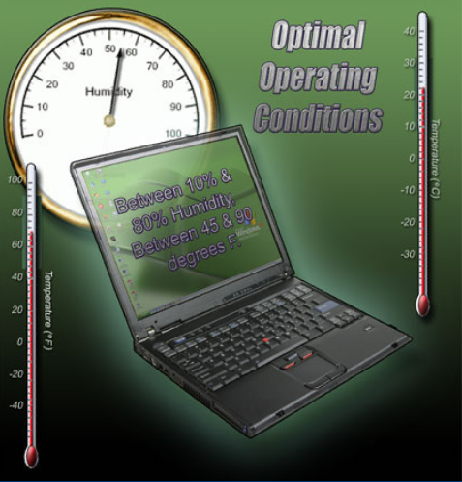
Optimal Operating Environments
Pack for transport
Clean properly
Ventilate
Air temperature
Humidity
Notes:
6.6.2 Identify optimal operating environments
An optimal operating environment for a laptop is clean, free of potential contaminants, and within the temperature and humidity range specified by the manufacturer.
Follow these guidelines to help ensure optimal operating performance from your laptop:
Pack laptops and all accessories securely to prevent damage during transport.
Clean the laptop frequently to remove dust and potential contaminants.
Do not obstruct vents or airflow to internal components. A laptop can overheat if air circulation is obstructed.
Keep the room temperature between 45 to 90 degrees Fahrenheit (7 to 32 degrees Celsius).
Keep the humidity level between 10 to 80 percent.
Note: Temperature and humidity recommendations will vary by laptop manufacturer. You should research these recommended values, especially if you plan to use the laptop in extreme conditions.

Slide 31
Troubleshooting Process
Step 1 Identify the problem
Step 2 Establish a theory of probable causes
Step 3 Determine an exact cause
Step 4 Implement a solution
Step 5 Verify solution and full system functionality
Step 6 Document findings
Notes:
6.7 Describe how to troubleshoot laptops and portable devices
Computer problems can result from a combination of hardware, software, and network issues. Computer technicians must be able to analyze the problem and determine the cause of the error to repair the computer. This process is called troubleshooting.

Slide 32
Step 1 - Identify the Problem
Laptop information
  Manufacturer, model, OS, network environment, connection type
Open-ended questions
  What problems are you experiencing with the laptop?
  What software has been installed recently?
  What were you doing when the problem was first identified?
  What error messages have you received?
Closed-ended questions (Can be answered with a ‘yes’ or no’)
  Is the laptop under warranty?
  Is the laptop currently using the battery?
  Can the laptop operate using the AC adapter?
  Can the laptop boot and show the operating system desktop?
Notes:
6.7.1 Review the troubleshooting process
Identify the Problem

Slide 33
Step 2 - Establish a Theory of Probable Causes
The problem may be simpler than the customer thinks.
Create a list of the most common reasons why the error would occur.
  Battery does not have a charge
  Battery will not charge
  Loose cable connections
  Keyboard does not work
  Num Lock key is on
  Loose RAM
Notes:
6.7.1 Review the troubleshooting process
Establish a Theory of Probable Causes

Slide 34
Step 3 - Determine the Exact Cause
Test your theories of probable causes one at a time, starting with the quickest and easiest.
  Use AC adapter with laptop
  Replace the battery
  Reboot the laptop
  Check BIOS settings
  Disconnect and reconnect the cables
  Disconnect peripherals
  Toggle Num Lock key
  Remove and reinstall RAM
  If Caps lock key is on, turn it off
  Non-bootable media in a boot device
  Password has changed
If the exact cause of the problem has not been determined after you have tested all your theories, establish a new theory of probable causes and test it.
Notes:
6.7.1 Review the troubleshooting process
Determine the Exact Cause

Slide 35
Step 4 - Implement a Solution
If a quick procedure does not correct the problem, you might need to research the problem further to establish the exact cause.
Divide larger problems into smaller problems that can be analyzed and solved individually.
Create a list of possible solutions and implement them one at a time. If you implement a possible solution and it does not work, reverse the solution and try another.
Notes:
6.7.1 Review the troubleshooting process
Implement a Solution
If a quick procedure does correct the problem, you can go to step 5 to verify the solution and full system functionality.
Evaluate the problem and research possible solutions. Divide larger problems into smaller problems that can be analyzed and solved individually. Prioritize solutions starting with the easiest and fastest to implement.
Check:
Helpdesk repair logs
Other techs
Manufacturer FAQs
Technical websites’
News groups
Computer manuals
Device manuals
Online forums
Internet search

Slide 36
Step 5 - Verify Solution and System Functionality
Verifying full system functionality and implementing any preventive measures if needed. This ensures that you have not created another problem while repairing the computer.
  Reboot the laptop
  Attach all peripherals
  Operate laptop using only battery
  Print a document from an application
  Type sample document to test keyboard
  Check Event Viewer for warnings or errors
Have the customer verify the solution and system functionality.
Notes:
6.7.1 Review the troubleshooting process
Verify Solution and System Functionality

Slide 37
Step 6 - Document Findings
Discuss the solution with the customer
Have the customer confirm that the problem has been solved
Give the customer all appropriate paperwork
Document the process in the work order and in your technician’s journal:
  Problem description
  Solution
  Components used
  Amount of time spent in solving the problem
Notes:
6.7.1 Review the troubleshooting process
Document Findings

Slide 38
Common Problems and Solutions
Laptop problems can be attributed to hardware, software, networks, or some combination of the three. You will resolve some types of laptop problems more often than others.
Notes:
6.7.2 Identify common problems and solutions
[Direct students to the chart (or charts) on the Identify common problems and solutions page in the course.]
Student Activity: The student course content includes the worksheet, 6.7.2 Research Laptop Problems. The instructor will provide the student with specifications of a particular laptop. Based on that information, the student will research the Internet for the manufacturer site, other websites providing resources to support and maintain that laptop and details of any service notices regarding the laptop specified.

Slide 39
Chapter 6 Summary
Laptops and PDAs are becoming increasingly popular due to reduced costs, lighter weights, increased capabilities, and battery power for portability.
PDAs and Smartphones are small handheld devices with many of the capabilities of a computer, such as an address book, calendar, e-mail, and Internet access.
Laptops and desktops have ports that are virtually the same, so peripherals are interchangeable. Laptops can use docking stations or port replicators to quickly connect to desktop peripherals and AC power.
Desktop and laptop components, such as motherboards, are not interchangeable. Additionally, laptop components tend to be proprietary to each manufacturer and designed with unique form factors.
The laptop CPU is designed to use less power and create less heat than the desktop computer. It uses CPU throttling to reduce power consumption and heat.
Notes:
6.8 Summary

Slide 40
Chapter 6 Summary (Continued)
Functionality of the laptop can be expanded by adding components via PC Card or ExpressCard slots and USB, Firewire, and parallel ports.
An important component of laptop portability is the ability to run on battery power. The current method of managing power is through the operating system with the Advanced Configuration and Power Interface (ACPI). The ACPI standard defines six power management states.
There are several components of a laptop that may need to be replaced. Steps are defined to replace the battery, optical drive, hard drive, memory, and PC Cards.
Cell phone standards were developed in the 1980s. The current third-generation standards enable cell phones to share some laptop functions, such as e-mail, Internet access, address, and calendar functions. Standards have not been adopted worldwide.
Preventive maintenance will ensure optimal operation of the laptop. It is important to keep the laptop clean and in safe environments. It is critical to use the correct materials and techniques when cleaning the various components of a laptop. Procedures for cleaning the components are presented.
Notes:
6.8 Summary

Slide 41
Chapter 6 Summary (Continued)
Dust, temperature, and humidity can affect laptop performance. Basic guidelines are to keep the laptop clean, with good ventilation and room temperature between 45 to 90 degrees F (7 to 32 degrees C) and humidity levels in the range of 10 to 80 percent.
Always verify that repair of a laptop is cost-effective.
Troubleshooting laptop problems requires the technician to identify, repair, and document the problem. Troubleshooting steps include: Gather data from customer, verify the obvious, try quick solutions first, gather data from the computer, evaluate the problem, implement the solution, and close with the customer.
When troubleshooting wireless-capable devices, check all status LEDs and signal strength indicators. Remove all unnecessary peripherals to isolate the problem.
Notes:
6.8 Summary

Slide 42
Chapter 6 Summary (Continued)
Check for external problems, such as connection errors, power errors, and function key errors. Connection errors can often be solved by removing and reinserting components. Check in Device Manager for errors. Power errors can be caused by the use of incorrect adaptors, damaged batteries, damaged AC adaptors, or dead wall outlets. Check components controlled by Function keys.
Try quick solutions first to solve laptop problems. Reboot and verify the BIOS settings, start the laptop in safe mode, and use the Last Known Good Configuration Option.
For problem resolution, gather information from the computer from the Device Manager, Network Settings, Power Options, Event Viewer, and System Configuration.
Resources for troubleshooting should include the following: other technicians, Internet resources, manufacturers’ FAQs, and online forums.
The final steps in the troubleshooting process are to test the laptop in all scenarios, discuss the solution with the customer, fill out all necessary paperwork and billing documents, and document the solution.
Notes:
6.8 Summary

Slide 43


